Slide 1
Intro to dig image processing

Slide 2
Outline
- Basic methodology
- HW1: Greyscale
- HW2: Connected Component
- HW3: Histogram Equalization

Slide 3
Basic methodology
(R, G, B) = (0, 0, 255)
Numpy Array
Picture

Slide 4
Basic methodology
(R, G, B) = (0, 0, 255)
Numpy Array
Function

Slide 5
HW1: Greyscale
Color
Greyscale

Slide 6
HW1: Greyscale
(R, G, B) = (?, ?, ?)
(R, G, B) = (?, ?, ?)
Function?
Numpy Array (Before)
Numpy Array (After)

Slide 7
HW1: Greyscale
Function 1 (Easiest)
Gray = (Red + Green + Blue) / 3
Function 1I (Photoshop)
Gray = (Red * 0.3 + Green * 0.59 + Blue * 0.11)
Function..
More…

Slide 8
HW1: Greyscale
Real use: use library “Pillow”
import sys from PIL
import Image
def greyscale(name):
return Image.open(name).convert('LA')

Slide 9

HW2: CONNECTED COMPONENT
12 Connected Component

Slide 10
HW2: CONNECTED COMPONENT
Algorithm “Flood Fill”

Slide 11
Basic methodology
(R, G, B) = (0, 0, 255)
Numpy Array
Function

Slide 12
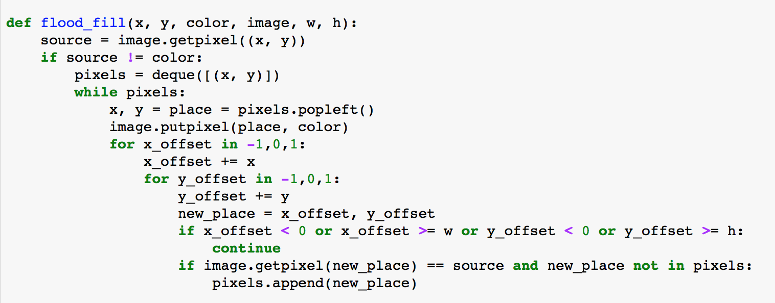
HW2: CONNECTED COMPONENT
Code

Slide 13

HW2: CONNECTED COMPONENT
Output
12 Color = 12 CC

Slide 14
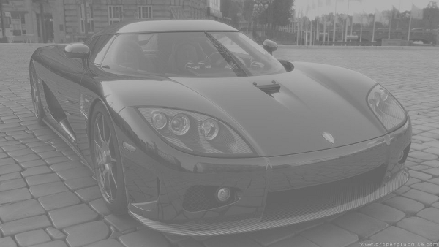
HW3: Histogram Equalization
Function?
Before
After

Slide 15
HW3: Histogram Equalization
Function?
Before
After

Slide 16
HW3: Histogram Equalization
Algorithm
Find PDF (histogram)
Find CDF
Scale on CDF
Map to new scale

Slide 17
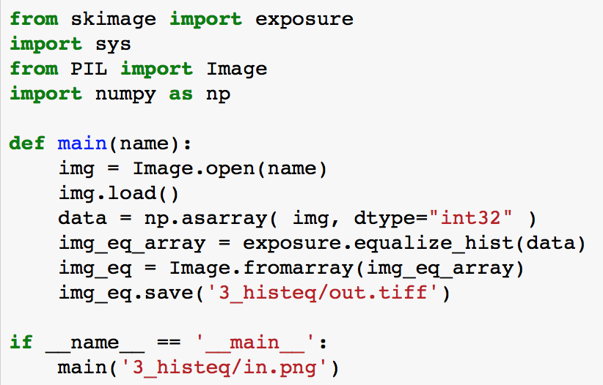
HW3: Histogram Equalization
Real use: use library “Scikit Image”
Code

Slide 18
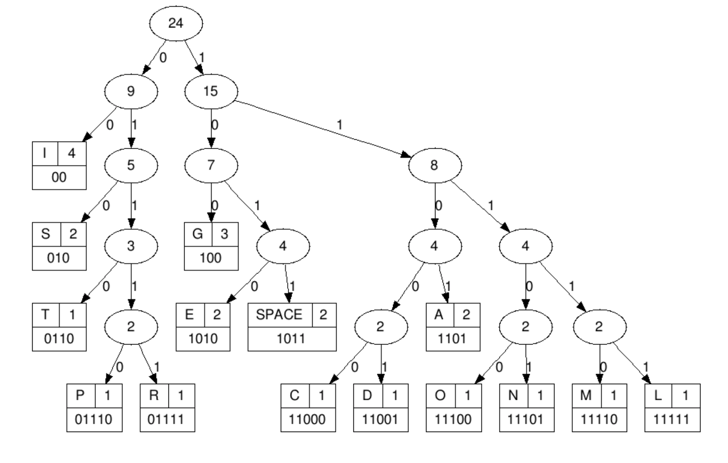
HW4: Huffman Coding

Slide 19
THANK You
For your attention

